Slide 2
The Same but Different: Preparing and Presenting Your Case in Arbitration Versus Litigation
April 30, 2025

Slide 3
Thomas Cunningham
Partner
Sidley Austin LLP
Sarah Gordon
Partner
Steptoe LLP
Frank Papalia
Jonathan Rosen
*All comments of the speakers are made in their individual capacity and not on behalf of their current or former companies, law firms, or clients

Slide 4
Introduction
ARBITRATION
LITIGATION
VS.

Slide 5
Sample Arbitration Clause

Slide 6
Arbitration – Key Considerations
1. Scope – “dispute” between the parties “with reference to the interpretation of this Agreement or their rights with respect to any transaction involved”
2. Arbitrators – tripartite panel, active executive officers; no attorney requirement
3. Umpire selection – “drawing lots”

Slide 7
Arbitration – Key Considerations (cont’d)
4. Arbitrators’ powers
Honorable engagement
Released from “judicial formalities” and “following the strict rules of law”
Effect general purpose in reasonable manner not literal interpretation of language
5. Other matters
Confidentiality expectations
Fees and expenses
Implications for parol evidence
Implications for punitive damages, injunctive relief, etc.

Slide 8
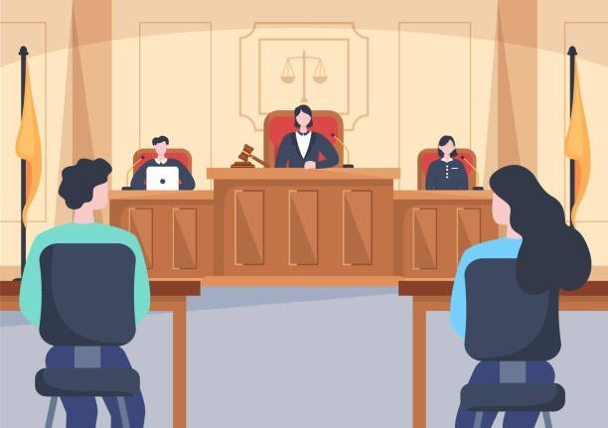
Litigation – Key Aspects
1. Federal or state court
2. Rules of Civil Procedure
3. Rules of Evidence
4. Finder of Fact
Judge
Jury

Slide 9
Comparing Litigation and Arbitration
Goals and Methods
Proportionately / burden
Document authentication
Admission
Dispositive motion practice
Use of experts

Slide 10
Comparing Litigation and Arbitration (cont’d)
Written Discovery
Scope / volume
E-discovery
Interrogatories and requests for admission
Privilege

Slide 11
Comparing Litigation and Arbitration (cont’d)
Oral Discovery
Scope / number of depositions
Corporate representative depositions
Witness preparation and presentation
Experts

Slide 12
Comparing Litigation and Arbitration (cont’d)
Motion Practice
Non-dispositive
Dispositive

Slide 13
Comparing Litigation and Arbitration (cont’d)
Pretrial or Pre-hearing
Motions in limine
Briefs
Burden of proof
Conference
Jury instructions/verdict forms

Slide 14
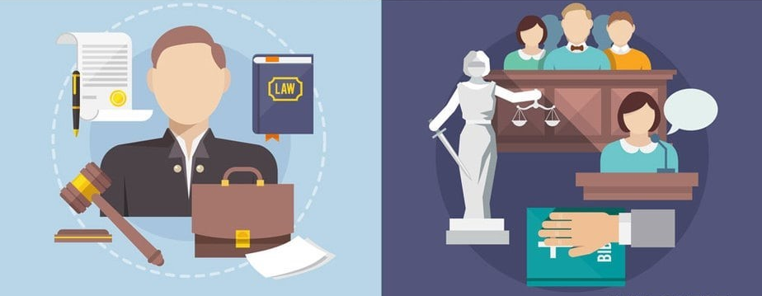
Hearing / Trial
If litigation:
Bench or Jury

Slide 15
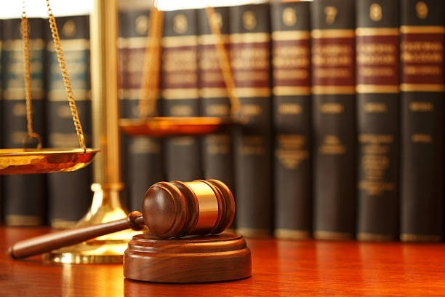
Hearing / Trial (cont’d)
Evidentiary Rules and Objections
Relevancy
Materiality
Probative vs. prejudice
Admissibility
Hearsay
Expert testimony
Privilege

Slide 16
Hearing / Trial (cont’d)
Openings and Closings
Themes
Demonstratives
Scope and depth
Use of evidence

Slide 17
Hearing / Trial (cont’d)
Witness Testimony
Preparation
Sequence and scope
Direct examination
Cross-examination
Deposition transcripts
Witness statements

Slide 18
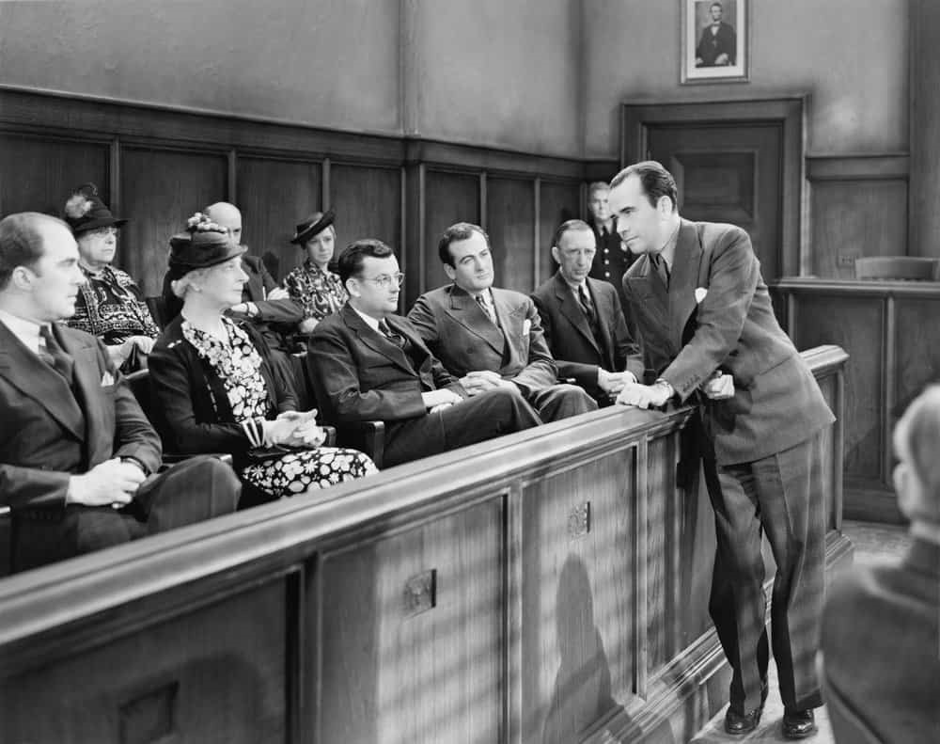
Hearing / Trial (cont’d)
Jury Considerations
Simplify
Streamline
Explain

Slide 19
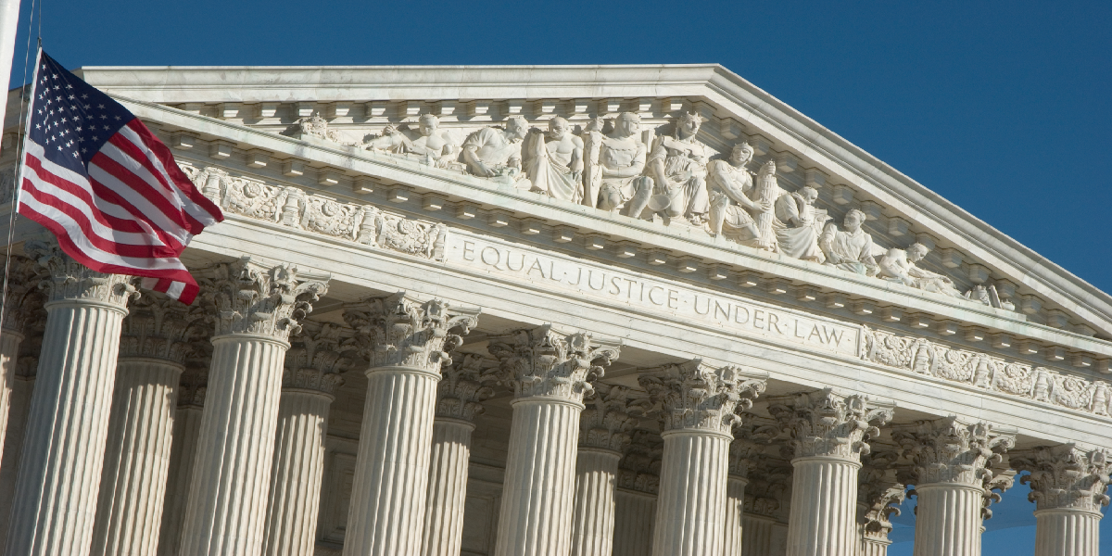
District Court Review of Arbitration
Arbitration
Vacatur (9 U.S.C. § 10)
Modification or correction (9 U.S.C. § 11)
Timing (9 U.S.C. § 12)
Scope (Hall Street)

Slide 20
Appellate Rights - Litigation
Litigation
Scope
Timing
Standard
Appellate procedural rules

Slide 21
Questions?

