Slide 2
Emerging Risks
May 1, 2025
Frank DeMento | Transatlantic Re
Jim Dolan | Enstar
Lisa Simon | Swiss Re
Jack Vales | Dentons US LLP

Slide 3
Meeting you today
Frank DeMento Transatlantic Re
Lisa Simon Swiss Re
Jim Dolan Enstar US
Jack Vales Dentons

Slide 4
AGENDA
Microplastics
PFAS
Climate Change Litigation/Legislation
Psychedelics
Alcohol
Ultra Processed Food

Slide 5
Microplastics
Particles smaller than 5 millimeters that slough off plastic as it degrades.
Microplastics smaller than 1 micrometer (a strand of DNA is approximately 2.5 nm), known as nano-plastics, can infiltrate cells.
Microplastics are everywhere: toothpaste contains microbeads; drinks stored in plastic bottles; food that is packaged, stored, and microwaved in plastic; trash, dust, fabrics, cosmetics, cleaning products, rain, seafood, produce, table salt, and in water from community water supplies or private wells.
Microplastics have been detected throughout the human body, including in the blood, lungs, testicles, saliva, liver, kidneys, and placenta.

Slide 6
Human Health Effects
Humans consume 5 grams of microplastics each week, which is about the weight of a credit card.
The human brain contains about 7 grams of microplastics — roughly the weight of an average plastic spoon.
Exposure has also been linked to:
An increased risk of heart attack and stroke
Some cancers
Impaired immune response
Growth retardation
Reduced fertility
The FDA continues to monitor the research on microplastics and nanoplastics. If the FDA determines, based on scientific evidence, that microplastics or nanoplastics in food, including packaged food and beverages, adversely affect human health, the FDA will take regulatory action to protect public health.

Slide 7
State Statutes and Regulations
FDA’s Microbead-Free Waters Act prohibits the manufacture and distribution of rinse-off cosmetics containing intentionally added microbeads.
Connecticut Public Act 15-5 Sec. 50 — Microbead Ban
California AB 888 — Waste management: Plastic microbeads
Illinois SB 2727 — EPA – Cosmetic Product – Microbead
Wisconsin SB 15 — Manufacture and acceptance for sale of products containing microbeads.
Colorado HB 15-1144: Prohibit Plastic Microbeads Personal Care Products

Slide 8
Litigation
Actions have been filed against bottled water companies alleging they falsely labeled, marketed, or advertised their bottled water as “natural” when the water contained unnatural microplastics.
“BPA free” is being challenged as misleading under the theory that consumers allegedly interpret “BPA free” to mean that the product is free of all microplastics.
Consumer plaintiffs claim they would not have bought the products had they been aware of the presence of these substances.
Plaintiffs often assert consumer protection claims in tandem with claims for breach of warranty, fraud, and failure to warn.

Slide 9
Per- and Poly-Fluoroalkyl Substances (“PFAS”)

Slide 10
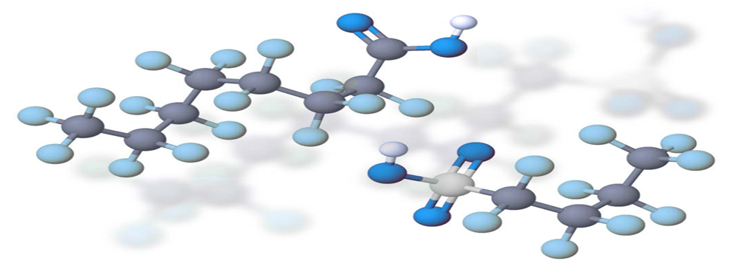
Per- and Poly-Fluoroalkyl Substances (“PFAS”)
PFAS is the commonly used abbreviation for organic compounds with replacement of most or all hydrogen atoms by fluorine in the aliphatic chain structure.
PFAS can be traced back to 1938. One of the earliest and most popular uses of PFAS was DuPont’s Teflon and 3M’s Scotchgard.
They are called “forever chemicals” because PFAS are known for their ability to repel oil and water, their stability and resistance to heat and fire, and they are resistant to any methods designed to break apart the atoms within the chemical.
Most Americans, about 97%, have PFAS chemicals in their blood.
Verisk’s analysis, “suggests ground up losses from PFAS litigation could stretch north of $100B, ranging between $120B - $165B, depending on how certain trends evolve.”

Slide 11
Per- and Poly-Fluoroalkyl Substances (“PFAS”)
The first PFAS case was a 2004 class action lawsuit captioned Leach et al. v. E.I. du Pont de Nemours & Co., No. 01-C-698 (Wood County W.Va. Cir. Ct).
An independent scientific panel found probable links between exposure to PFAS and kidney and testicular cancer, ulcerative colitis, thyroid disease, pregnancy-induced hypertension, and high cholesterol. (1) $1.6 million compensatory reward for a kidney cancer plaintiff.
(2) $5.1 million compensatory and $500,000 punitive award to a testicular cancer plaintiff; and
(3) $2.1 million compensatory and $10.5 million punitive award for a testicular cancer plaintiff.
DuPont agreed to settle 3,500-plus cases in the class for $670 million.
(1) $50 million compensatory award to a testicular cancer plaintiff.
(2) $83 million for remaining cases
DuPont also agreed to establish an escrow account funded by $1 billion with a $4 billion aggregate cap for potential future PFAS liabilities.

Slide 12
Per- and Poly-Fluoroalkyl Substances (“PFAS”)
Litigation has expanded to include consumer product retailers like L’Oréal, Target, Burger King and Chick-Fil-A.
Strict product liability theories allege that consumer product retailers failed to disclose/warn of the presence of PFAS within the products they sell, violation of state consumer protection statutes, false and misleading advertisement, negligent design and manufacture.
In the matter of Hoffnagle et al. v. Connecticut Water Company, No. 3:2023-cv-01489 (Ct. Dist. 2023), plaintiffs allege that the municipal water itself, as a product, was defective as it contained elevated levels of PFAS.
Largest pending PFAS litigation consists of over 8,400 pending cases that are being litigated on a consolidated docket venued in a South Carolina Federal District Court. The MDL is related to a single product, AFFF, a fire suppressant.

Slide 13
Regulation
April 10, 2024, the EPA finalized the National Primary Drinking Water Regulation. The EPA set a limit for PFAS compounds found in public drinking water of 4 parts per trillion (the equivalent of one drop of water in 5 Olympic-sized swimming pools). The EPA Press Release on the matter advises:
“First-ever national, legally enforceable drinking water standard to protect communities from PFAS”
“Exposure to PFAS has been linked to deadly cancers, impacts to the liver and heart, and immune and developmental damage to infants and children. The rule will reduce PFAS exposure for approximately 100 million people, prevent thousands of deaths, and reduce tens of thousands of serious illnesses.”
“The science is clear that PFAS chemicals are linked to a wide range of health harms including cancer, damage to cardiovascular and immune systems, poor pregnancy outcomes, and effects on the developing child.”

Slide 14
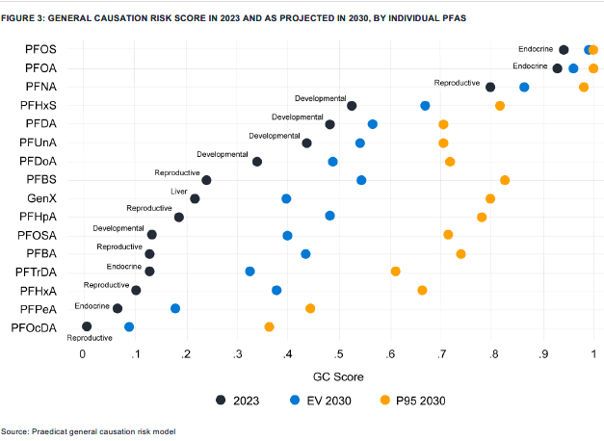
Causation

Slide 15
Coverage
“Occurrence” means an accident, including continuous or repeated exposure to substantially the same general harmful conditions.
This insurance does not apply to:
Expected or Intended Injury “Bodily injury” or “property damage” expected or intended from the standpoint of the insured.
We will pay those sums that the insured becomes legally obligated to pay as damages because of “bodily injury” or “property damage” to which this insurance applies. We will have the right and duty to defend the insured against any “suit” seeking those damage.

Slide 16
Coverage
Pollution Exclusion Caselaw
In Tonoga Incorporated v. New Hampshire Insurance Company, No. 532546, 2022 N.Y. App. Div. LEXIS 105 (App. Div. 3rd Dep’t Jan. 6, 2022) the court supported the application of the pollution exclusion in the PFAS context where the claims arose from traditional environmental pollution at a manufacturing facility.
In Wolverine Worldwide v. American Insurance Co., 1:19-CV-10, 2021 WL 4841167 (W.D. Mich. Oct. 18, 2021), the court found that in the PFAS context, the carrier’s denial based upon their pollution exclusion was not appropriate as the sudden and accidental exception (used pre-1986) to the pollution exclusion precluded a denial of coverage.
In Colony Insurance v. Buckeye Fire Equipment, 2020 U.S. Dist. LEXIS 194709 (W.D.N.C. Oct. 20, 2020), the court held that the pollution exclusion applied only to traditional environmental pollution, which did not include bodily injury from direct contact with a pollutant. The Court therefore reasoned that the exclusion did not apply to the underlying claims in the PFAS AFFF litigation.

Slide 17
Climate Change Litigation / Legislation

Slide 18
Litigation Basics
Major Decisions
Predictions
Regulation and Legislation
Insurance issues
Will see more failure to adapt claims and secondary effects litigation.
Potential stranded asset claims.
More claims against financial institutions.
More professional liability claims.
Federal level/impact of Trump rollbacks
State level:
Climate change disclosure laws
Polluter / emitter pays laws
Private rights of action laws
Who is being sued?
Large emitters, governments, financial institutions, businesses for climate/greenwashing or failure to protect against climate change impacts (Secondary effects litigation).
Who are the plaintiffs?
Government entities
Certain Occupations (e.g., miners, fisherman, firefighters)
Residents of certain areas (e.g., near waterways, wildfire prone areas).
Against governments
Against emitters
Against other businesses
Pending US cases
Pending non-US cases: Lliuya, Milieudefensie.
CC will impact multiple lines of business.
Both legacy and current policy years are exposed.
Coverage issues include pollution exclusions, trigger, allocation, expected / intended, number of occurrences.
U/W options – avoid certain types of risks, try to exclude, cover with conditions, sublimits, among other options.

Slide 19
Psychedelics / Psychoactive Substances

Slide 20
What are they and why are they a concern
Benefits / Risks
Legality
Litigation
Insurance Issues
Substances that affect the brain or lead to altered states of consciousness. Examples include kratom, ketamine, psilocybin, MDMA.
Increasingly being used due to easy availability, evidence of potential health benefits, less stigma, social media.
Can overdose or injure others due to use.
.
Who is being sued? Producers, retailers, medical professionals, pharmacies, therapists, employers.
Both individual suits and class actions.
Allegations include failure to warn, breach of warranties.
Treat depression, pain, anxiety, PTSD
Feelings of euphoria
Emotional / spiritual breakthroughs
Long term effects not known
Can cause anxiety, hallucinations
Short term physical effects / risks of overdosing
Federal level – some legal, some not.
State level - legality varies by substance / state. May be legal but highly regulated.
Lines of business potentially impacted include Med Mal, Professional Liability, D&O, GL.
Seeing some coverages specifically tailored to psychedelic risk.

Slide 21
Alcohol

Slide 22
Alcohol Claims
Over the past year, we have seen a surge of reporting regarding the cancer risks posed by even light or moderate alcohol consumption.
Recent human epidemiology studies conclude that a causal association exists between study participant’s light, moderate, or heavy alcohol consumption and an increased risk of developing certain cancers, including:
Head and neck cancer
Esophageal cancer
Liver cancer
Breast cancer
Colorectal cancer
The National Cancer Institute estimates around 75,000 cancer cases and 19,000 cancer deaths in the U.S. each year are linked to alcohol.
Global health agencies are beginning to use phrase “there is no safe level” of drinking alcohol.

Slide 23
Alcohol Claims: The Next Mass Tort?
Possible Legal Liability
Because the alcohol industry has never warned about cancer risks, every regular drinker (light, moderate, heavy) who develops a potentially alcohol-related cancer would possibly have a personal injury claim under traditional product liability theories.
Possible State AG Litigation
As alcohol consumption is ubiquitous in our society, it is conceivable that State Attorneys General could also potentially sue industry participants on a public nuisance theory.
Key defenses will include product identification, causation, assumption of the risk/comparative negligence, product misuse, statutes of repose, and others.
As in opioids litigation, manufacturers would likely challenge public nuisance claims due to 1) absence of a violation of a public right or property nexus, 2) manufacturer’s lack of control of product once sold, and 3) the availability of product liability remedies to address products lawfully sold.

Slide 24
Ultraprocessed Foods (UPFs)

Slide 25
UPFs
UPFs typically have more than 1 ingredient that you never or rarely find in a kitchen. They also tend to include many additives and ingredients that are not typically used in home cooking, such as preservatives, emulsifiers, sweeteners, and artificial colors and flavors.
Examples includes mass-produced bread, breakfast cereals, instant soups, ice cream, fruit-flavored yogurts, reformulated potato snacks like Pringles, hot dogs, vegan meat, and energy drinks.
Evidence has recently developed linking consumption of UPFs and negative health outcomes.
A range of issues could come under attack – from the hyper-palatability of UPFs and their alleged addictive (obesity-causing) nature, to the harmful effects of some of the artificial additives commonly used in UPFs (e.g. artificial sweeteners, emulsifiers, flavorings etc.).
This could in turn fuel litigation against food manufacturers and distributors.

Slide 26
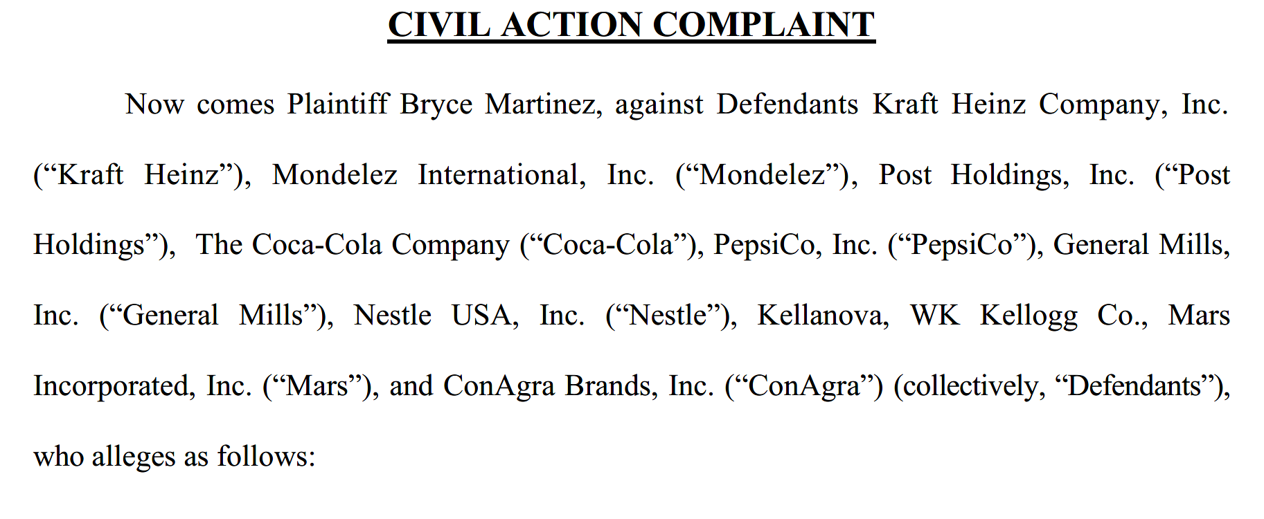
UPF Litigation
A new UPF litigation was filed in December 2024 in the Philadelphia County Court of Common Pleas by Plaintiffs’ Law Firms Morgan & Morgan and Seeger Weiss.
In a classic “reptile-like” approach, the 147-page Complaint seeks to villainize the processed food-industry, place the corporate conduct of the industry squarely on trial, and connect the UPF marketing strategies to Big Tobacco.

Slide 27
UPF Litigation
UPF litigation could encompass manufacturers of a broad range of foods, including foods generally considered as "healthy", such as baked goods or baby formula. Distributors, marketing agencies and food supply chains could also be implicated.
Inadequate warnings on labels and/or overly aggressive marketing to certain segments of the population, including children, could lead to "health-washing" lawsuits and advertising liability exposure.
D&O claims could also arise if firms overpromise in their public filings and corrections are thereafter made, potentially leading to a drop in share price and related securities fraud lawsuits.

Slide 28
Legal Disclaimer
The information contained in this presentation and any discussions or statements made during its presentation are general in nature and intended to be used for informational purposes relating to this discussion only and are not intended for any particular purpose. The views expressed do not necessarily represent the views of Transatlantic Reinsurance Company, its parents, affiliates, subsidiaries, management and/or shareholders (collectively, “TransRe”), who along with the authors shall not be held responsible in any way for use of or reliance on any of the information contained in or referenced during the presentation of these materials. This same disclaimer likewise applies to Swiss Re, Enstar Group, Dentons, and their respective parents, affiliates, subsidiaries, management, shareholders, partners, representatives, and/or clients.

Slide 29
Legal Disclaimer
The information contained in this presentation is not intended to constitute and should not be considered legal or professional advice, nor shall it serve as a substitute for obtaining legal or professional advice specific to any particular needs that may be presented. TransRe makes no representation, does not guarantee, and assumes no liability for the accuracy or completeness of, or any results obtained by application of, this presentation and information provided herein. This same disclaimer likewise applies to Swiss Re, Enstar Group Limited, Dentons, and their respective parents, affiliates, subsidiaries, management, shareholders, partners, representatives, and/or clients.

Slide 30
Questions?

